Slide 1
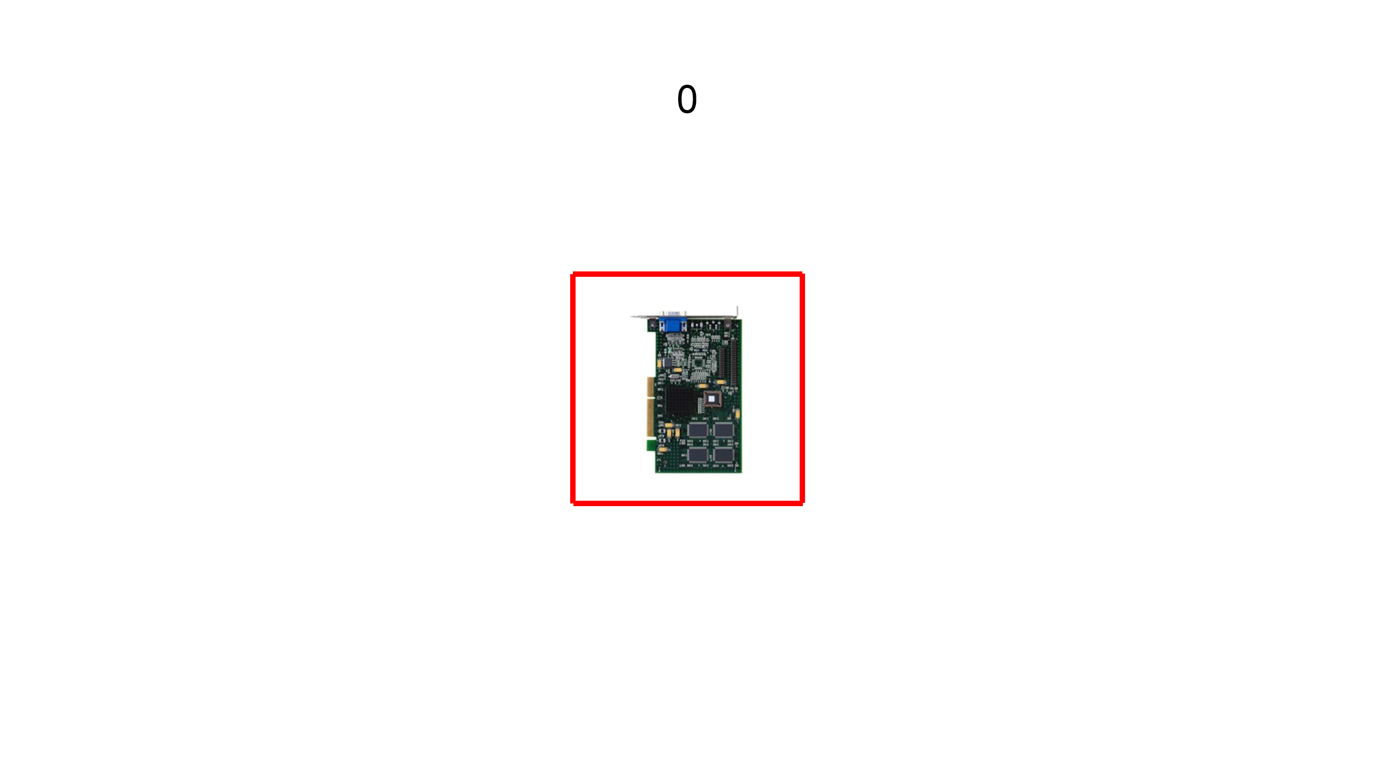
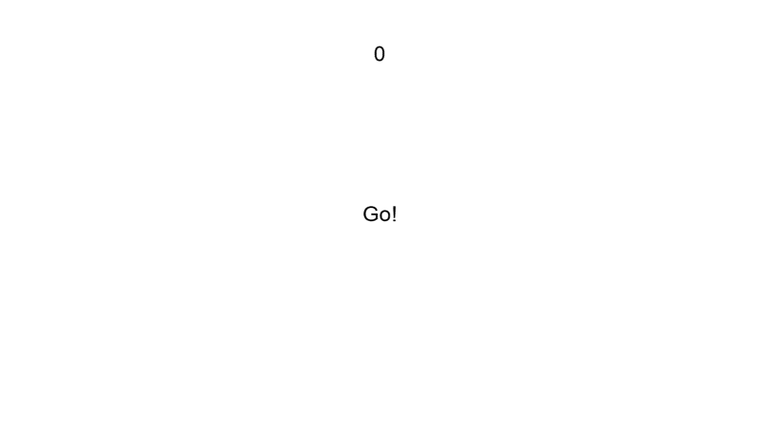
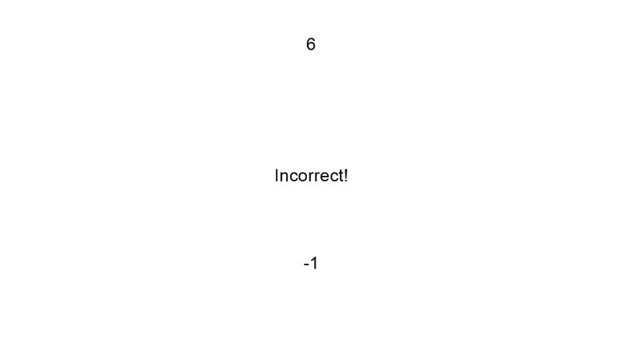
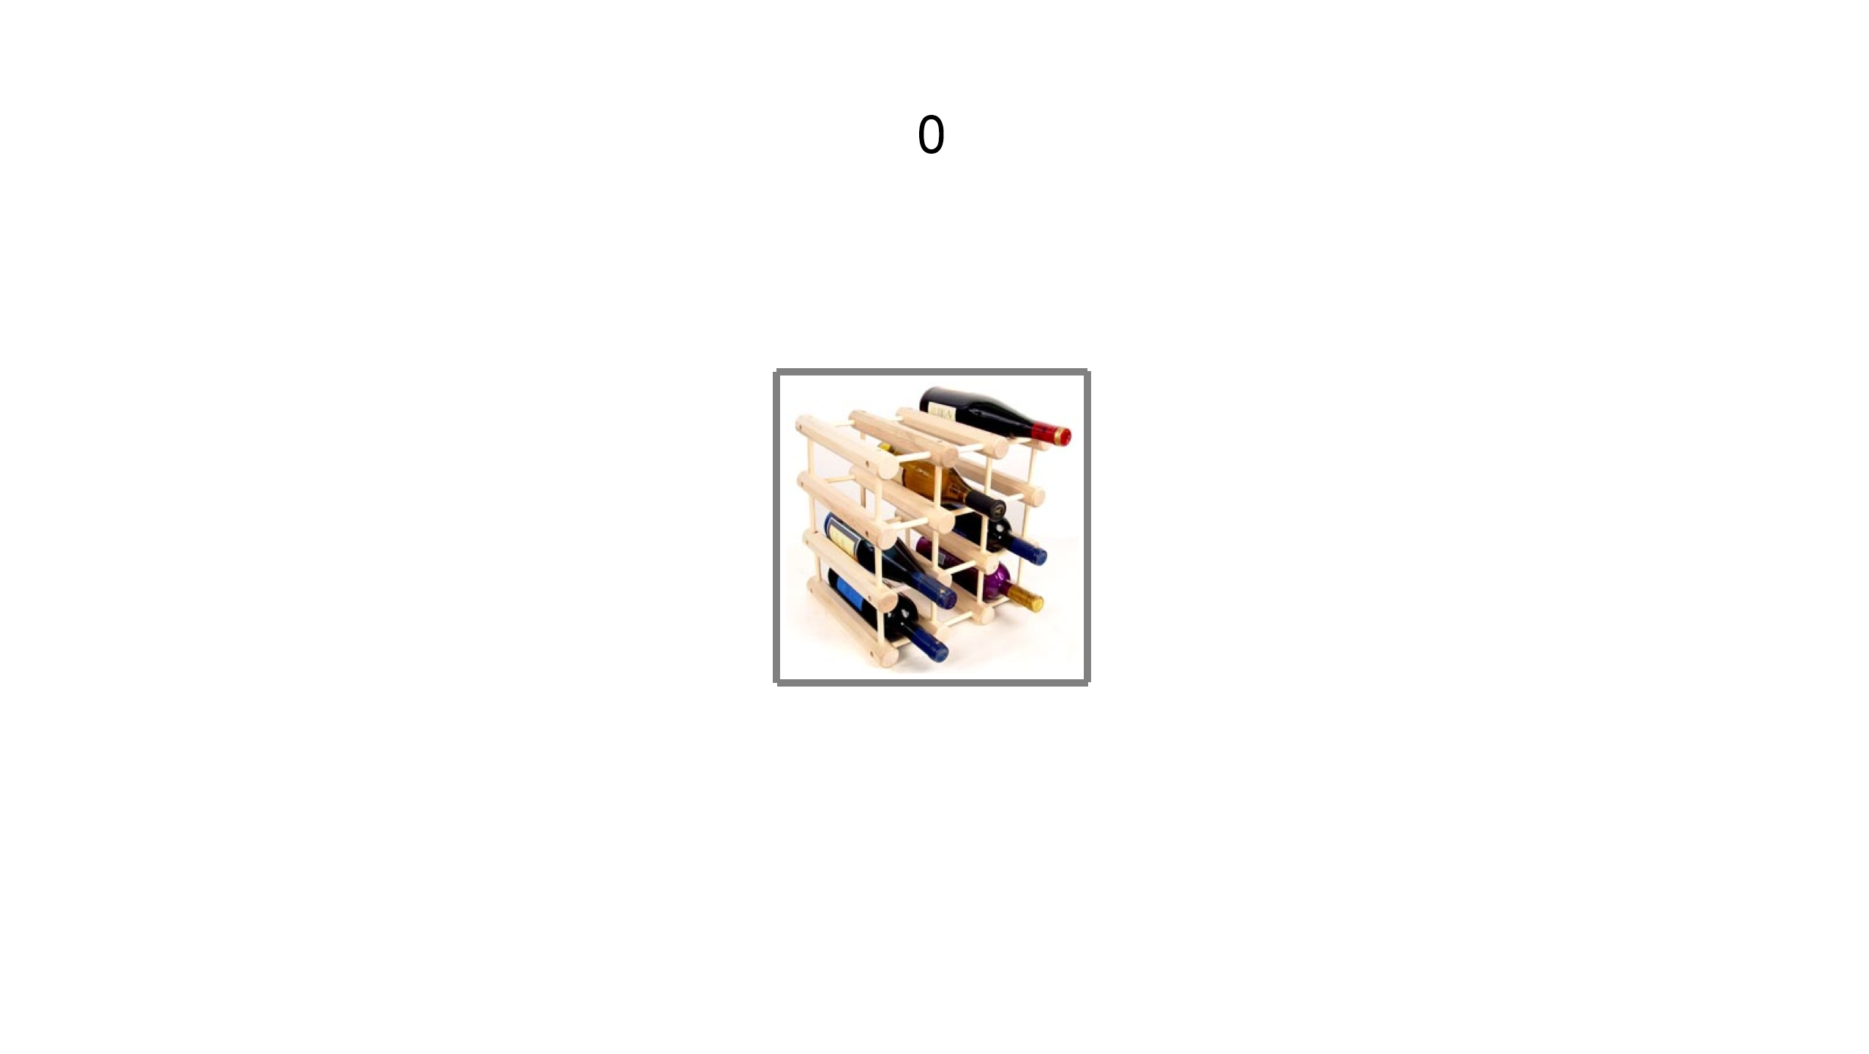
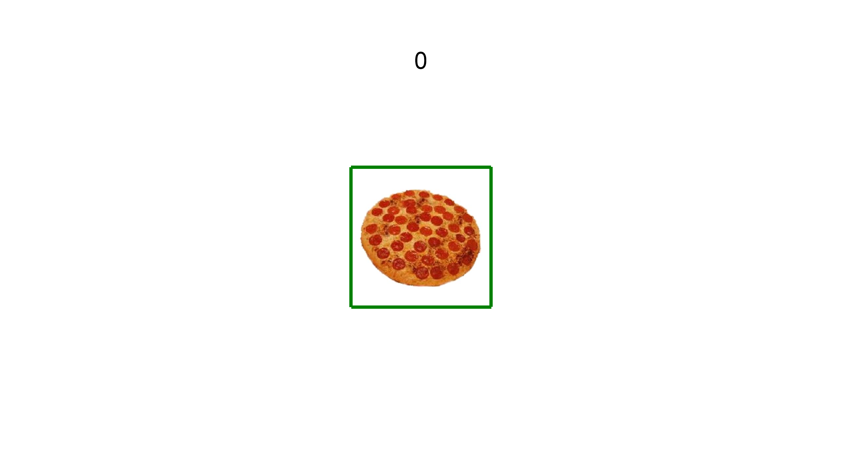
Lose
Maintain
Gain
Cue + Stimulus
2000ms
ISI
4000-
6000ms
Response Window
500ms
ISI
4000-
6000ms
Feedback
2000ms

